Slide 1
Probability & Random Processes EE2011 Department of Electrical Engineering
NATIONAL UNIVERSITY OF COMPUTER & EMERGING SCIENCES, LAHORE CAMPUS

Slide 2


Slide 3




Slide 4


Slide 5



Slide 6


Slide 7
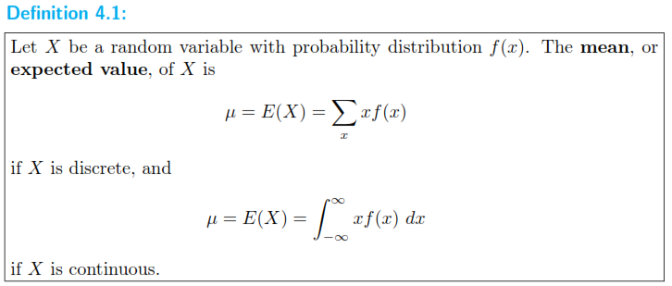

Slide 8




Slide 9


Slide 10


Slide 11




Slide 12




Slide 13



Slide 14





Slide 15
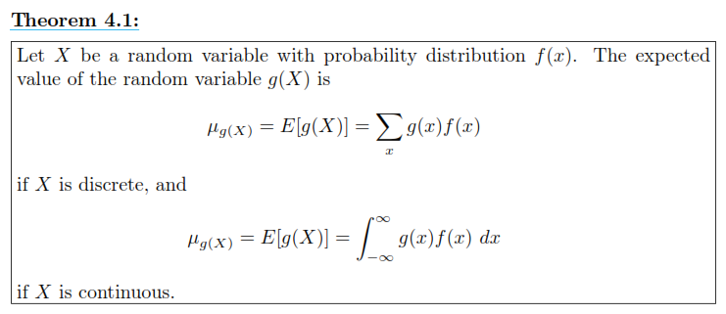

Slide 16





Slide 17

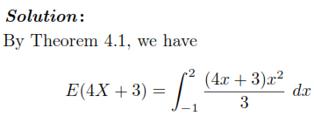


Slide 18
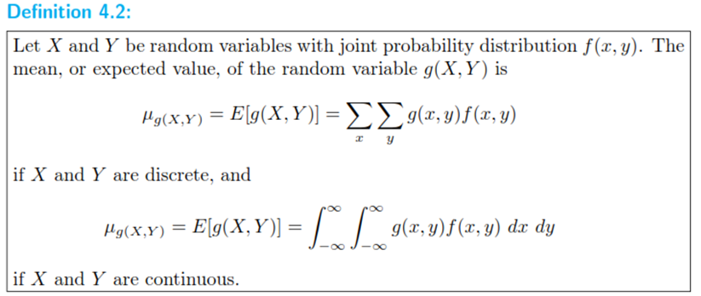

Slide 19






Slide 20





Slide 21




Slide 22


Slide 23
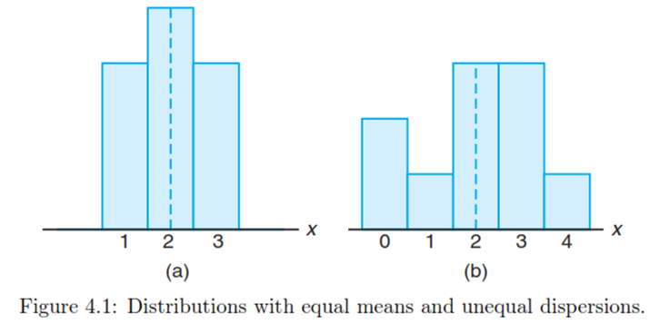


Slide 24


Slide 25
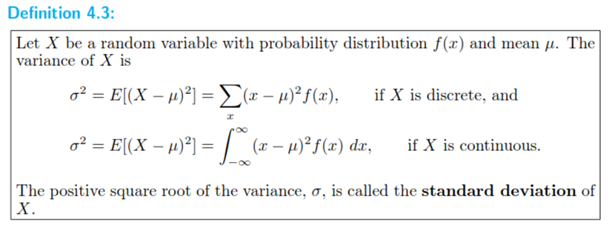


Slide 26

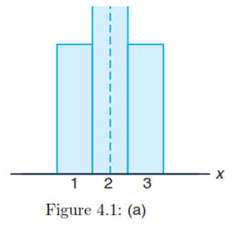


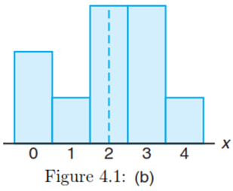


Slide 27






